Slide 1
Molecular Weight Measurements Using Static Light Scattering

Slide 2
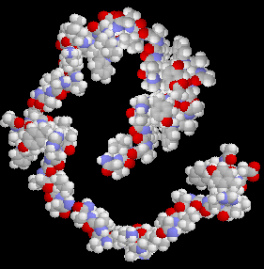
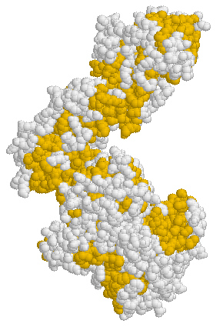
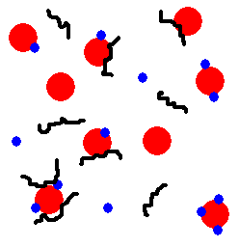
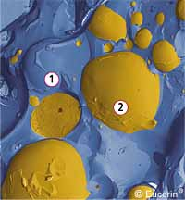


What Samples Are Suitable For SLS?
Proteins
Polymers
Dendrimers
YES
Liposomes
Emulsions
Mixtures
NO

Slide 3
Static Light Scattering (SLS)
The intensity of scattered light that a macromolecule produces is proportional to the product of the weight-average molecular weight and the concentration of the macromolecule (I α (M_{W})(C))
The Zetasizer Nano S and ZS measures the intensity of scattered light of various known concentrations of sample at one angle
This is called a Debye plot and allows for the determination of
Weight-Averaged Molecular Weight
2nd Virial Coefficient

Slide 4
2nd Virial Coefficient (A₂)
A thermodynamic property describing the interaction strength between the molecule and the solvent
For samples where A₂ > 0, the molecules tend to stay in solution
When A₂ = 0, the molecule-solvent interaction strength is equivalent to the molecule-molecule interaction strength – the solvent is described as being a theta solvent
When A₂<0, the molecule will tend to crystallise or aggregate

Slide 5
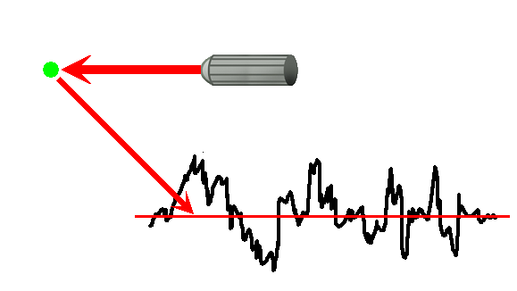
Static Light Scattering
I ∝ (MWt) (C)
(Rayleigh Equation)
K = Optical constant C = Concentration
M_{W} = Molecular weight R_{θ} = Rayleigh Ratio of the sample
A₂ = 2nd Virial coefficient P(θ) = Shape factor
Notes:
The convoluted expression for the scattering intensity given in the previous slide can be simplified to the Rayleigh equation form shown here, where the Geometric factor (G_{F}) and the incident intensity (I_{o}) have been integrated into the Rayleigh ratio (R_{θ}) of scattered to incident light intensity. For small particles, the shape factor, P(θ), is equivalent to 1. Under these conditions, the Rayleigh equation is linear with concentration, with an intercept equivalent to 1/M and a slope proportional to the 2nd virial coefficient. It is this form that is commonly used in static light scattering (SLS) experiments, where the particle molecular weight and 2nd virial coefficient are determined from the concentration dependence of the average scattering intensity.

Slide 6
Static Light Scattering
λ_{o} = laser wavelength
N_{A} = Avogadro’s number
n_{o} = Solvent RI
dn/dc = differential refractive increment
R_{g} = Radius of gyration
θ = Measurement angle
I_{A} = lntensity of analyte (sample I – solvent I)
n_{o} = Solvent RI
I_{T} = Intensity of standard (toluene)
n_{T} = Standard (toluene) RI
R_{T} = Rayleigh ratio of standard (toluene)

Slide 7
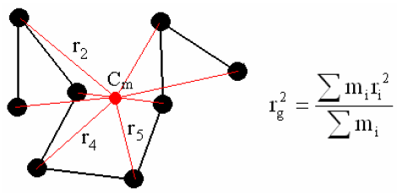
Radius of Gyration (R_{g})
R_{g} is defined as the mass weighted average distance from the centre of mass to each mass element in a macromolecule

Slide 8
Static Light Scattering
For Rayleigh scatterers, P(θ) = 1 and the equation is simplified to
(y = mx + c)
Therefore a plot of KC/R_{θ} versus C should give a straight line whose intercept at zero concentration will be 1/M and whose gradient will be A₂

Slide 9
Molecular Weight Example (Lysozyme in PBS)
I_{tol} = 192630 (counts/sec)
I_{sol} = 21870 (counts/sec)
Lysozyme Conc^{n} (mg/ml) | Measured Intensity (counts/sec) | Intensity of Analyte (counts/sec) | KC/R_{θ} (1/Da)
1.006 | 87,830 | 65,960 | 6.1994 x 10⁻⁵
3.018 | 222,900 | 201,030 | 6.4765 x 10⁻⁵
5.029 | 366,770 | 344,900 | 6.6682 x 10⁻⁵
10.059 | 742,570 | 720,700 | 6.7743 x 10⁻⁵

Slide 10
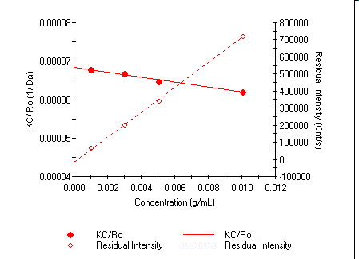
Molecular Weight Example (Lysozyme in PBS)
1/Intercept = 14.6KDa
Gradient = -3.23 x 10⁻⁴

Slide 11
Zetasizer Nano SLS M_{W} Specifications
For single angle M_{W} measurements with Zetasizer Nano system:
Globular proteins
Up to 32 nm diameter
Up to 20,000,000 Da (g/mol)
Random coil polymers
Up to 42 nm diameter
Up to 500,000 Da (g/mol)

Slide 12
Setting Up a Molecular Weight Measurement in the Zetasizer Software

Slide 13
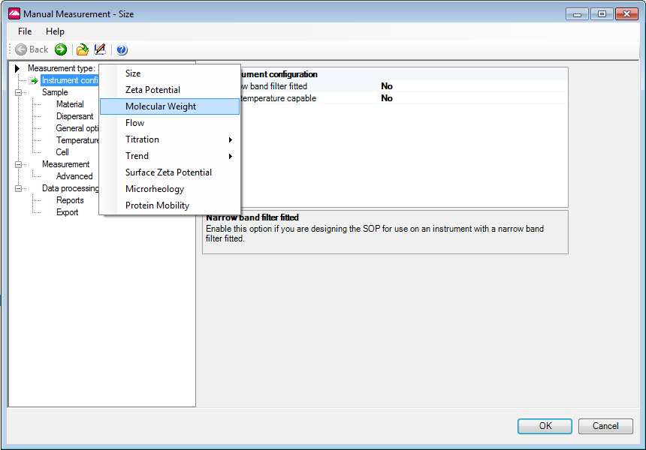
Molecular Weight SOP: Measurement Type
Measurement type must be selected at the start of the SOP set up
Otherwise all set up information is lost if another measurement type is selected

Slide 14
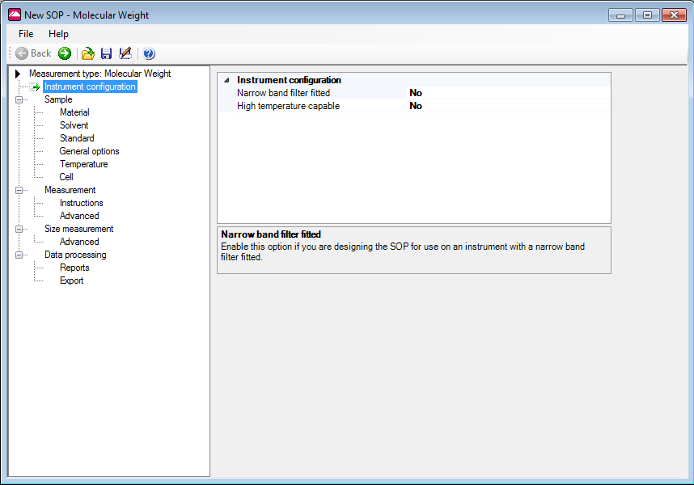
Molecular Weight SOP: Instrument Configuration
Molecular weight measurements can be made on a Nano S90/ZS90 but it is not recommended due to lower sensitivity

Slide 15
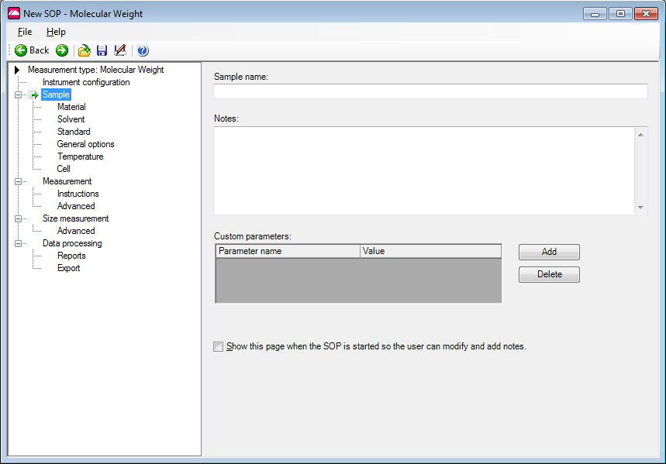
Molecular Weight SOP: Sample
Enter sample name, any notes and custom parameters

Slide 16
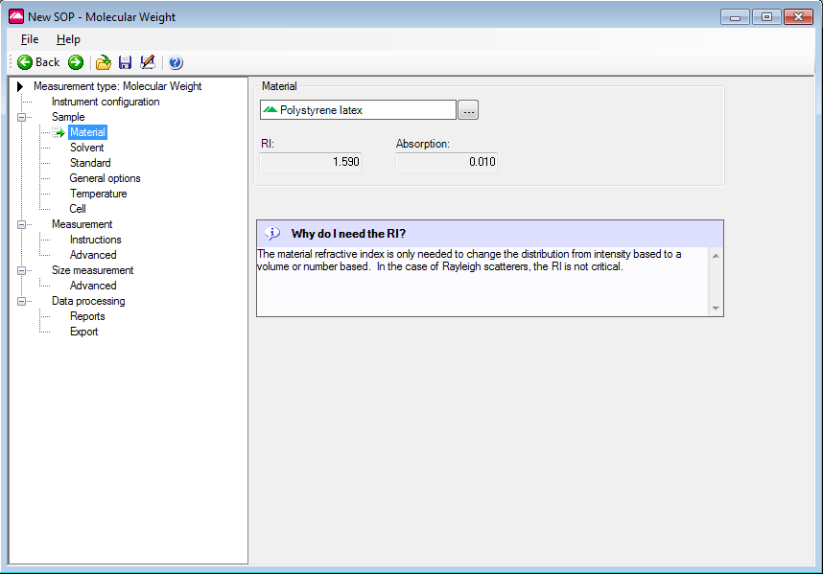
Molecular Weight SOP: Sample - Material
Material information only needed for documentation purposes
Optical properties not used in any molecular weight calculation

Slide 17
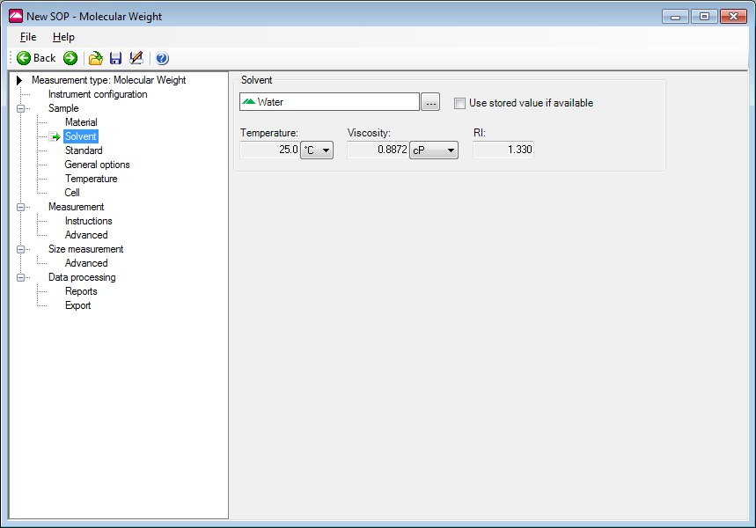
Molecular Weight SOP: Sample - Solvent
Solvent RI important for molecular weight determination
Solvent viscosity important if size measurement is being performed
Option of using stored solvent scattering value if available

Slide 18
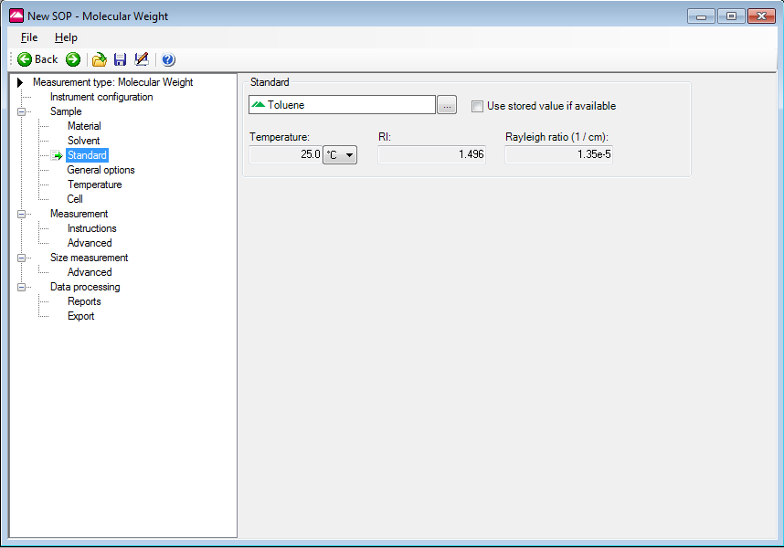
Molecular Weight SOP: Sample - Standard
Rayleigh ratio and RI values for toluene at 633nm and 532nm supplied in software
Option of using stored standard scattering value if available

Slide 19
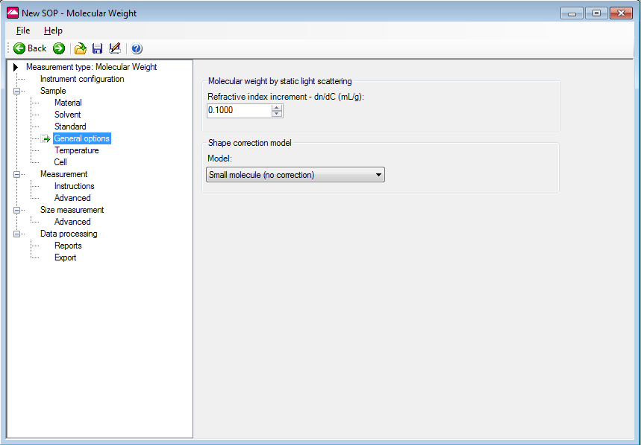
Molecular Weight SOP: Sample - General Options
Differential refractive index increment dn/dc specific for sample in solvent at the laser wavelength

Slide 20
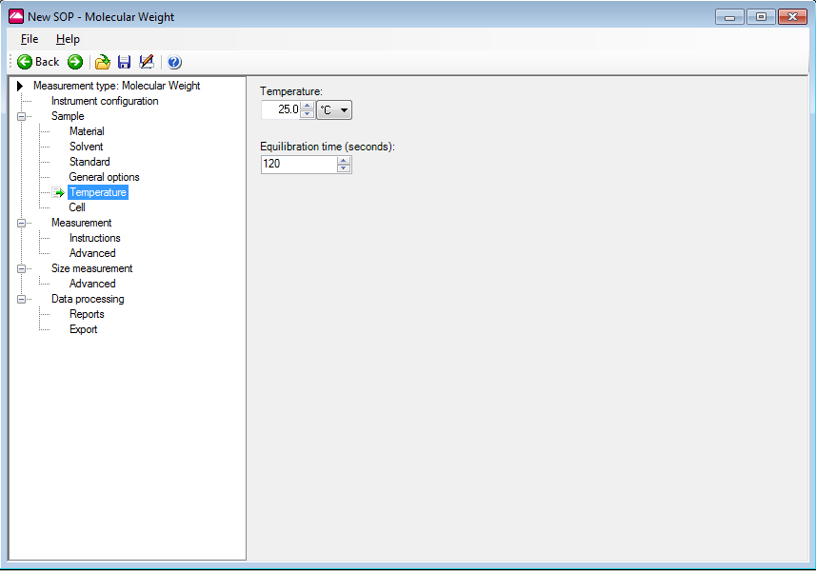
Molecular Weight SOP: Sample - Temperature
Temperature equilibration important to minimise scattering intensity cycling due to temperature related, refractive index differences of solvent/ standard

Slide 21
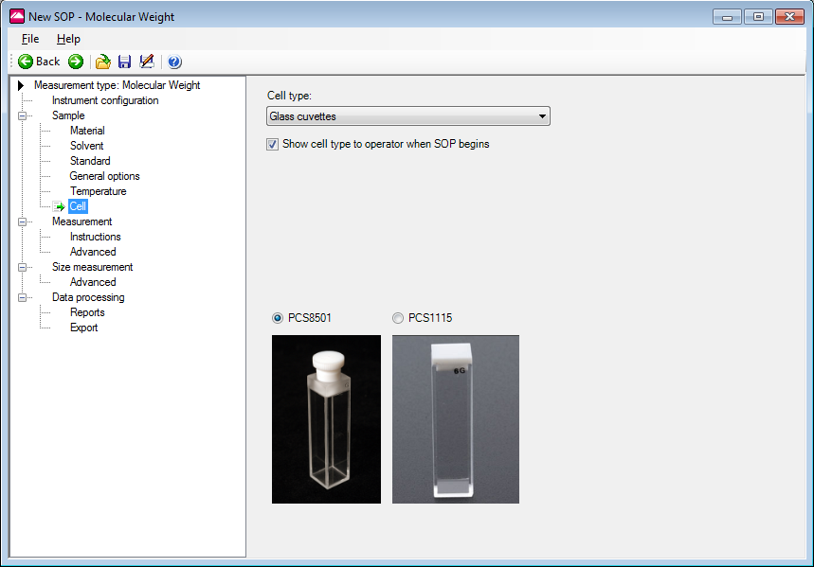
Molecular Weight SOP: Sample - Cell
Only glass (or quartz) cells recommended due to their higher optical quality

Slide 22
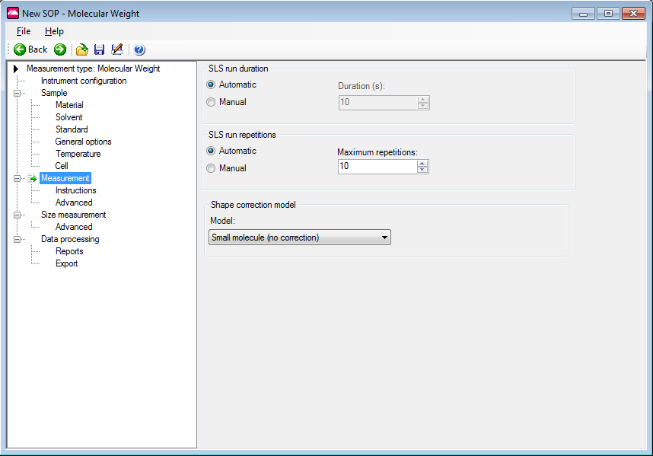
Molecular Weight SOP: Measurement
The measurement duration setting affects the accuracy and repeatability of the results

Slide 23
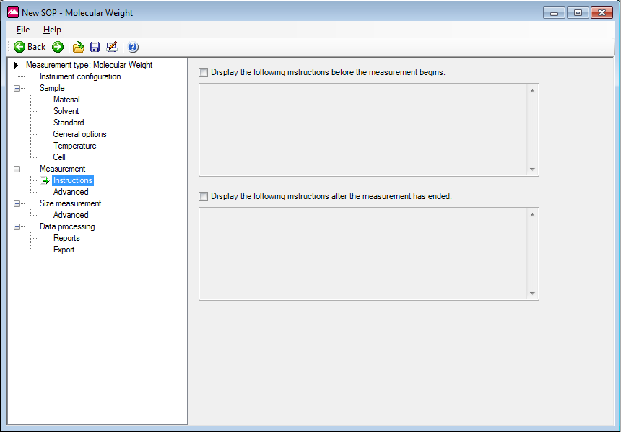
Molecular Weight SOP: Measurement - Instructions
Allows instructions to the user to be displayed both before and/or after running an SOP

Slide 24
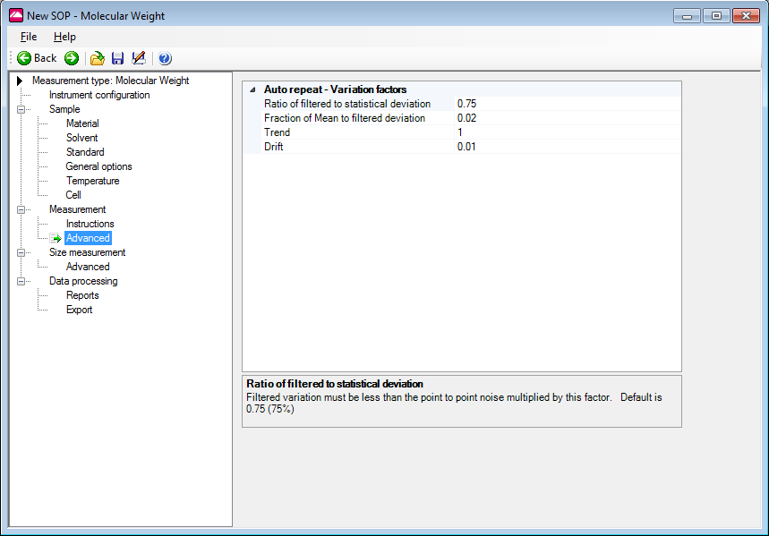
Molecular Weight SOP: Measurement - Advanced
Allows users the option to adjust the (variation) factors that are used in determining the length of an automatic duration measurement

Slide 25
Molecular Weight SOP: Measurement - Advanced
A number of count rate measurements are taken, one every 20ms, for the run length specified
The automatic default will normally be 10 seconds though this may increase for lower scattering samples to help increase the accuracy
The run duration range should typically be within the range 10 to 50 seconds

Slide 26
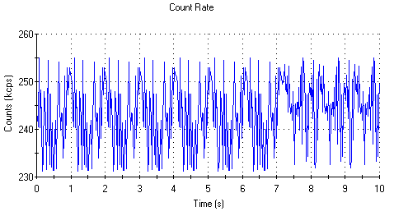
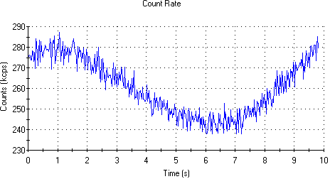
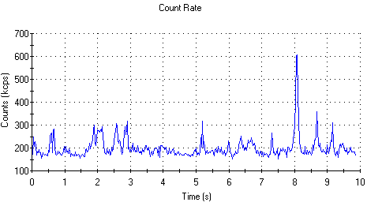
Molecular Weight SOP: Measurement - Advanced
Performing only one run may not always be sufficient to achieve a good measurement of the intensity because the sample scattering will normally show some systematic variations as well as an expected statistical (random) variation about a mean value
Statistical variation
Systematic variation

Slide 27
Molecular Weight SOP: Measurement - Advanced
These systematic variations can occur for several reasons:
Thermal drifting of the sample
Poorly mixed sample
Sample contains aggregates/dust
Instrument and laser stabilisation after initial switch on
If any variations are detected that are greater that are greater than the set values, the measurement will be repeated until a result below the thresholds is achieved
Adjusting these variation factors will enable a percentage of these systematic variations to be ignored during the measurement process allowing a quicker measurement to be performed e.g. if the sample contains aggregates/dust

Slide 28

Molecular Weight SOP: Measurement - Advanced
The default variation factors are:
Ratio of systematic to statistical deviation
The systematic deviation should be <0.75 x the statistical deviation

Slide 29

Molecular Weight SOP: Measurement - Advanced
The default variation factors are:
Ratio of systematic to statistical deviation
The systematic deviation should be <0.75 x the statistical deviation
Fraction of mean to systematic deviation
The systematic deviation should be <0.02 x the mean

Slide 30

Molecular Weight SOP: Measurement - Advanced
The default variation factors are:
Ratio of systematic to statistical deviation
The systematic deviation should be <0.75 x the statistical deviation
Fraction of mean to systematic deviation
The systematic deviation should be <0.02 x the mean
Trend
The trend (i.e. change in the mean between the start and end of the measurement) should be < statistical deviation x 1

Slide 31

Molecular Weight SOP: Measurement - Advanced
The default variation factors are:
Ratio of systematic to statistical deviation
The systematic deviation should be <0.75 x the statistical deviation
Fraction of mean to systematic deviation
The systematic deviation should be <0.02 x the mean
Trend
The trend (i.e. change in the mean between the start and end of the measurement) should be < statistical deviation x 1
Drift
The trend (i.e. change in the mean between the start and end of the measurement) should be <0.01 x the mean

Slide 32
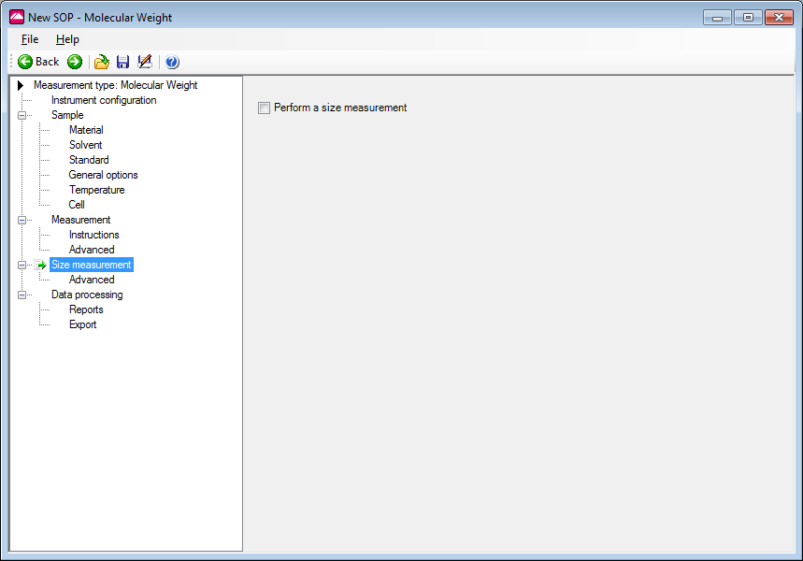
Molecular Weight SOP: Size Measurement
Size measurement is performed when box is checked
z-average diameter obtained for each sample concentration is extrapolated to zero concentration and this value is used for shape correction

Slide 33
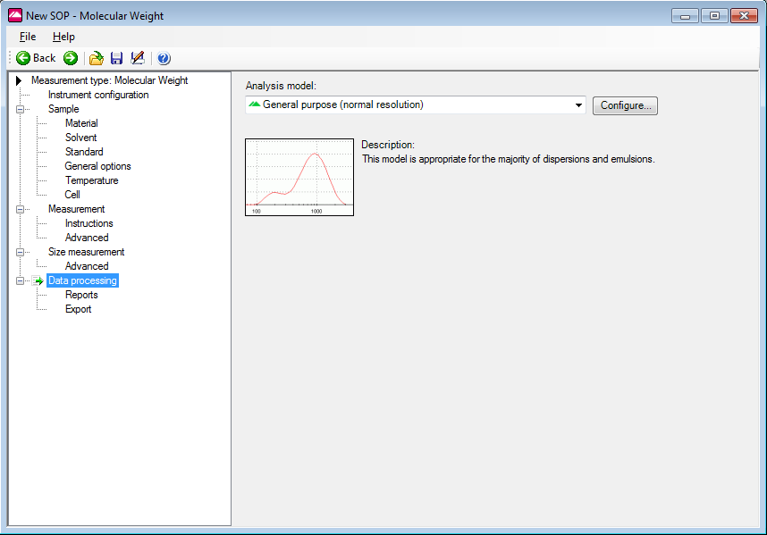
Molecular Weight SOP: Data Processing
Only required if size measurement has been requested

Slide 34
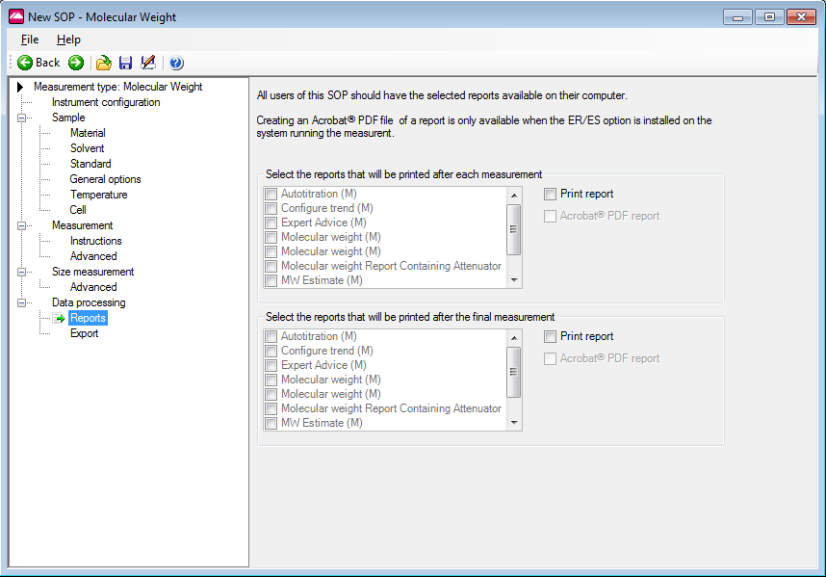
Molecular Weight SOP: Data Processing - Reports
Various reports can be selected and printed automatically

Slide 35
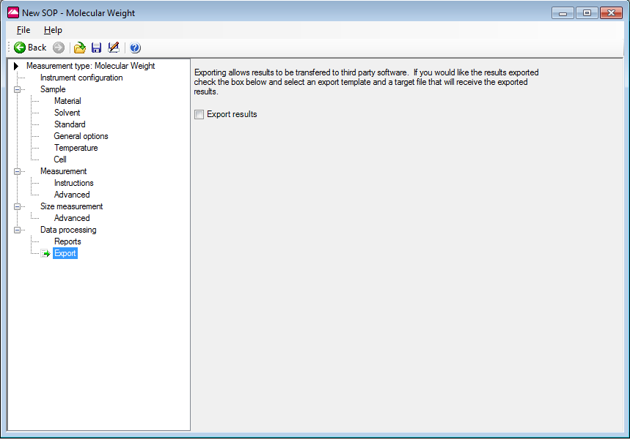
Molecular Weight SOP: Data Processing - Export
Enables the measurement results to be exported

Slide 36
Sample Preparation for Molecular Weight Measurements

Slide 37
Sample Preparation
Preparation of a number of known concentrations of the unknown molecule (protein, polymer) in a suitable solvent
Solvent
1
2
3
4

Slide 38
Sample Preparation
All glassware, pipettes, cuvettes and solvents used should be dust free
Filter all solvents, dispersants through appropriate filters (e.g. Whatman Anotop 20nm pore size filters)

Slide 39
Sample Preparation
Perform a sizing measurement on the stock concentration to check for modality, dust, aggregates
Ideally, the sample should consist of a single peak
If not, the sample needs to be filtered or centrifuged to remove any large material present
Measure the various sample concentrations using DLS to check if dilution influences the size

Slide 40
Measurement Procedure
Measurement of the intensity of scattering from a standard sample whose Rayleigh Ratio is known – this is recommended to be toluene as the value is known at various wavelengths
The Rayleigh ratio (R_{θ}) is the ratio of scattered to incident light intensity
The intensity of the incident light interacting with the macromolecule is difficult to measure
Therefore, the standard approach is to measure the scattering intensity of the analyte relative to that of a well described standard with a known Rayleigh ratio
A common standard used in light scattering is toluene (at 633nm the Rayleigh ratio is 1.3522 x 10⁻⁵ cm⁻¹)

Slide 41
Measurement Procedure
Differential refractive index increment (Dn/Dc) –
look up in literature (common values of dn/dc are provided in the FAQ library supplied with version 5.00 software)
measure using a differential or interferometric refractometer

Slide 42
Measurement Procedure
Measurement of the intensity of scattering from the zero concentration sample (if solvent is different to toluene)
Measurement of the intensity of scattering from the various concentrations of samples

Slide 43
What to Look For During a Molecular Weight Measurement

Slide 44
What to Look For During a Molecular Weight Measurement
Standard (Toluene) count rate should be at least 140kcps (on attenuator 11)
Count rate trace should be fluctuating with time over a narrow range of values
This is indicative of a sample free of large particles, aggregates or dust

Slide 45
What to Look For During a Molecular Weight Measurement
Standard (Toluene) count rate should be at least 140kcps (on attenuator 11)
Count rate trace should be fluctuating with time over a narrow range of values
This is indicative of a sample free of large particles, aggregates or dust
“Spikes” in the count rate trace indicate the presence of dust

Slide 46
What to Look For During a Molecular Weight Measurement
Standard (Toluene) count rate should be at least 140kcps (on attenuator 11)
Count rate trace should be fluctuating with time over a narrow range of values
This is indicative of a sample free of large particles, aggregates or dust
“Spikes” in the count rate trace indicate the presence of dust
“Cycling” of the count rate trace indicates that the sample is not thermally equilibrated

Slide 47
What to Look For During a Molecular Weight Measurement
If water or an aqueous buffer is used as the solvent, the count rate should be around 20 to 25kcps for the blank
Each increase in sample concentration should give an increase in the scattered light detected
The count rate increase should be linear with sample concentration

Slide 48
Molecular Weight Measurements
Data Interpretation

Slide 49
Molecular Weight Measurements
The Expert Advice System for molecular weight measurements only analyses the data from single measurements i.e. no information on trending from repeat measurements is provided

Slide 50
Molecular Weight Measurements
Test | Description | Details | Warning Message
1 | Check that the scattering from the various sample concentrations are appropriate | Is the count rate obtained from the various sample concentrations at least 10% more than the scattering obtained from the solvent? | The “A” g/ml concentration is producing less excess scattering (“B” kcps) than is advised. Ideally the scattering should be more than “C” kcps. Use a higher concentration of sample (where “A” is the concentration of the sample and “B” is the mean count rate in kcps of that sample and “C” is the minimum ideal scattering in kpcs calculated from ((scattering of solvent) + 10%)

Slide 51
Molecular Weight Measurements
Test | Description | Details | Warning Message
2 | Check that the scattering from the various sample concentrations are not too high | Is the count rate obtained from the various sample concentrations greater than 1000kcps? | The “D” g/ml concentration is producing more excess scattering (“E” kcps) than is advised. Ideally the scattering should be less than 1000 kcps. Use a lower concentration of sample (where “D” is the concentration of the sample and “E” is the mean count rate in kcps of that sample

Slide 52
Molecular Weight Measurements
Test | Description | Details | Warning Message
3 | Check the value of the correlation coefficient (R²) | Is the correlation coefficient (R²) < 0.9 | Low correlation coefficient (“F” < 0.9). Either remove outlying points or re-measure the samples at those concentrations. Use the Debye plot to identify outlying points (where “F” is the correlation coefficient (R²) calculated for the selected record)
R², the correlation or Pearson’s coefficient, is a calculated parameter that is used to describe how well graphical data fit an applied model
Values for R² range from 0 to 1, with a value of 1 indicating that there is zero deviation of the data from the model or best fit line (or curve)

Slide 53
Any Questions ?

